Slide 1




The Search Statement
This provides a quick way to search a table for particular values. To use this feature, the table must have an associated index.
FEU – EAST ASIA COLLEGE
Information Technology Department

Slide 2
Index
A system-assigned data field that references the different elements of a table – you do not define this field in your program.
Although it behaves like a numeric data item, you cannot adjust its value using mathematical statements. If you need to adjust an index, use the Set statement.
It is specified using the Indexed By clause on the same line as the occurs clause. Specify a unique data name after the words Indexed By.

Slide 3

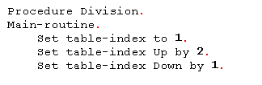
Index Declaration
To manipulate the value of the index, you must use the Set statement.

Slide 4
Search Statement
(First format : Searches the table from top to bottom)
Syntax:
Search <table to search>
at end <sentences to perform when
search fails>
when <condition>
<sentences to perform when
search is successful>
End-search

Slide 5
When coding the Search statement, the data item that is specified for the search is the one for which the Occurs clause has been coded.
The conditions that end the Search are coded using When. You may use multiple When clause, if any one of them is true, the statements after the associated When are executed. As soon as a When condition is true, the searching stops (similar to evaluate statement).
The statements that are executed when the search fails are coded after the clause At End.
The search proceeds from the present value of the index.
The end-search scope terminator is use to clearly separate the code after the When from the rest of the program.
When At End clause is present, it must occur before any when clauses.

Slide 6
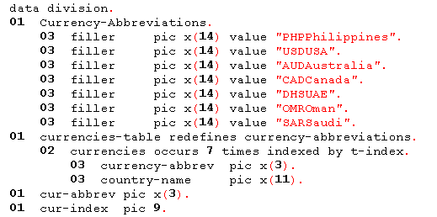
Search Statement – Example-1

Slide 7
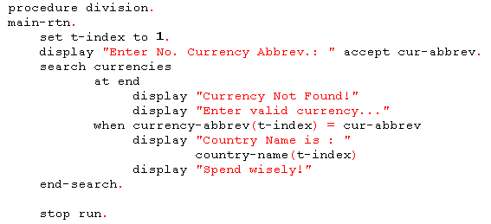

Slide 8
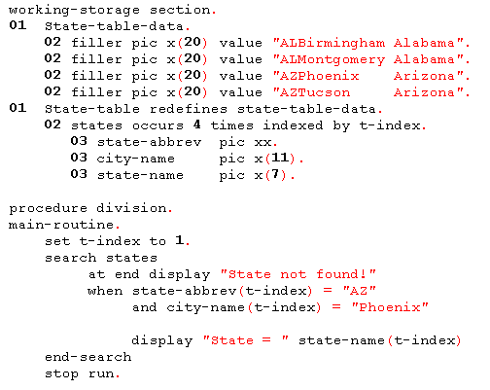
Search Statement – Example-2

Slide 9
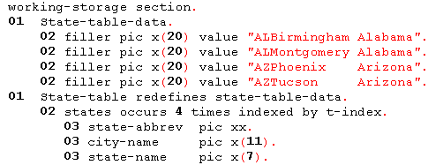
Search Statement – Example-3

Slide 10
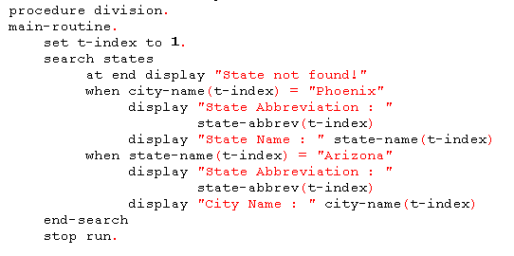

Slide 11
Search All Statement
To use Search All, the table must be indexed and keyed.
The elements of the table must be in ascending or descending key sequence.
The key fields are defined on the same line as the Occurs clause.
There may be only one When clause and must reference one of the key fields. However, the When clause may be coded with one or more And statements.
The And statements allow you to test for multiple conditions and must also reference one of the key fields.
No need for an initial value of the index.

Slide 12
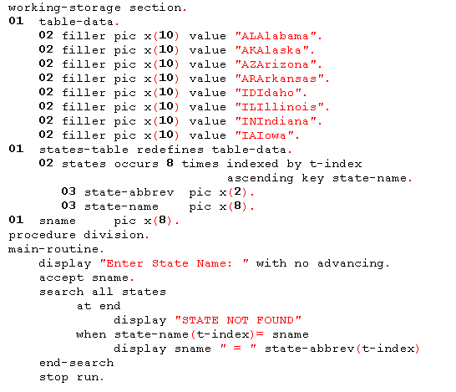
Search All Statement – Example-1

Slide 13
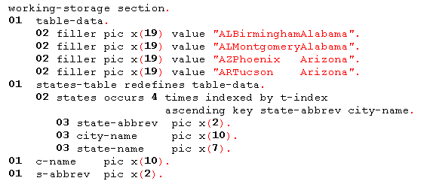
Search All Statement – Example-2

Slide 14
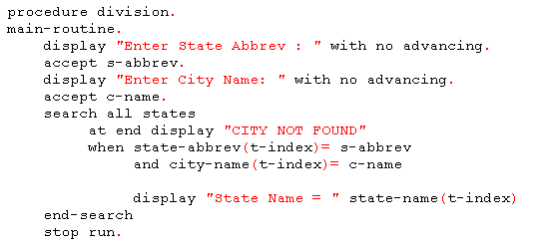

Slide 15
Multidimensional Table
COBOL tables can have up to 7 (seven) dimensions.
A two-dimensional table is a table within a table.
You can visualize a two-dimensional table as a file within a drawer in a file cabinet. The file cabinet is a table. The first dimension is the drawer number, and the second is the file within the drawer.

Slide 16

Two Dimensional Table Declaration
Example:

Slide 17



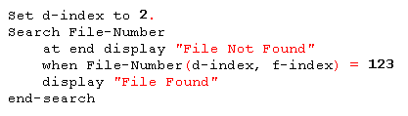
Accessing Two Dimensional Table
Example:

